Slide 1
Algorithms: Time Complexity and Big Oh notation
Joy Bose

Slide 2
Outline
Introduction to complexity
Importance of space/ time complexity
Big Oh notation
How to compute Big Oh for a computer program
Big omega and big theta
Example: Merge sort
Conclusion

Slide 3
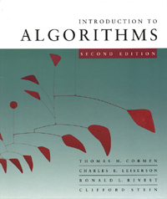
Introduction
Topic: Time and space complexity of algorithms
Big Oh notation is a way to denote how time or space needed by a program changes as number of inputs grows
It is a way to compare and evaluate different implementations
Part of algorithms course (textbook: Cormen Rivest or any other good textbook)

Slide 4
What is complexity of an algorithm
It is a way to indicate how good an algorithm grows, how well it scales with the number of inputs
It’s a mathematical term, used widely in computer science for analysis of algorithms
It matters more when the number of inputs is large
Can be: time complexity, space complexity
Time complexity: Measured in terms of number of primitive operations/steps

Slide 5
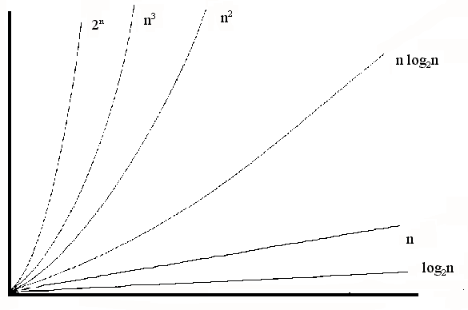
Time or space complexity: Why important
As input size grows larger, the total time/space needed to run the algorithm increases with complexity
Always important to optimize the algorithm for time (as well as space)
In real time scenarios, time is an important factor
Difference in time taken in running O(n) and O(n²) and O(2^{n}) etc

Slide 6
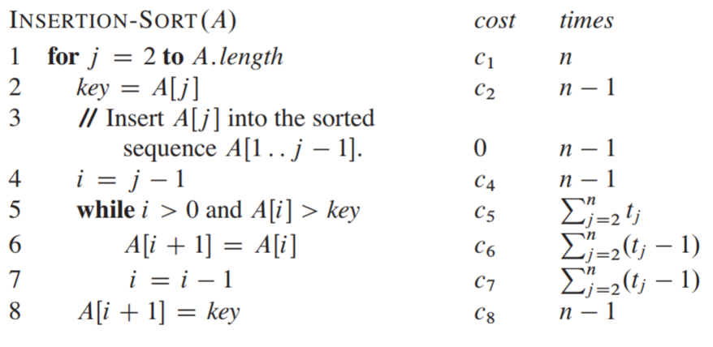
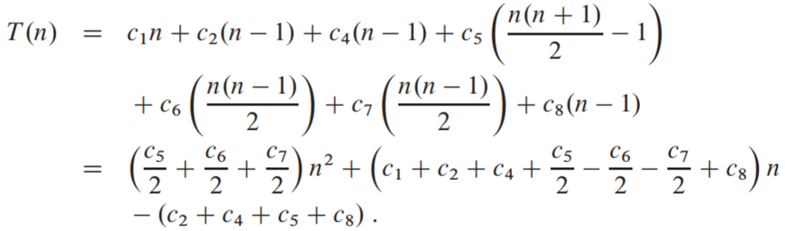
Analysis of insertion sort

Slide 7
Three types of analysis
Best case running time analysis
Average case: Average of running times for all possible combinations of the inputs
Worst case: This is the most important

Slide 8
Definition of Big O
Let f(x) and g(x) be functions on x where x is an integer.
We say that f(x) is O(g(x)) if there are constants C and n₀ such that
|f(x)| ≤ C|g(x)|
whenever x > n₀.
Example: 2x² + 3x + 5 is O(x²)
Usually take the highest index, ignore the constant terms and lower indices. As x grows larger, the bigger index takes precedence.

Slide 9
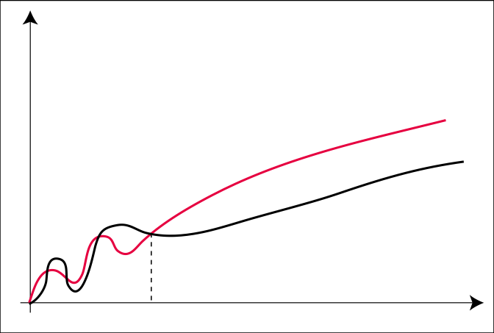
Illustration of Big Oh
f(x) is O(g(x))
For all x>n₀, cg(x) > f(x)
c ⋅ g
f
n₀

Slide 10
Some properties of Big Oh
If f₁(n) = O(g₁(n)) and f₂(n) = O(g₂(n)) then
f₁(n) + f₂(n) = O(g₁(n) + g₂(n))
For functions f(n) and g(n)
f(n) = O(g(n)) ⇒ f(n) + g(n) = O(g(n))

Slide 11
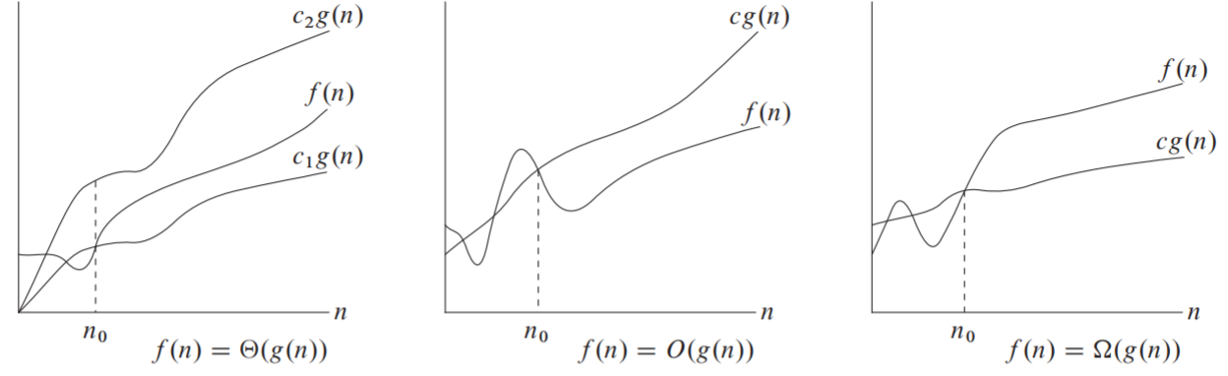
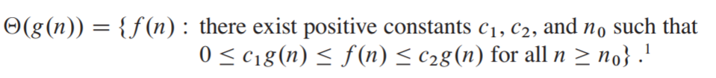

Big Omega and big Theta

Slide 12
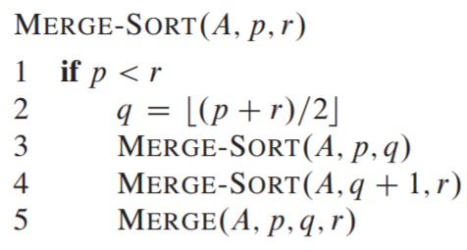
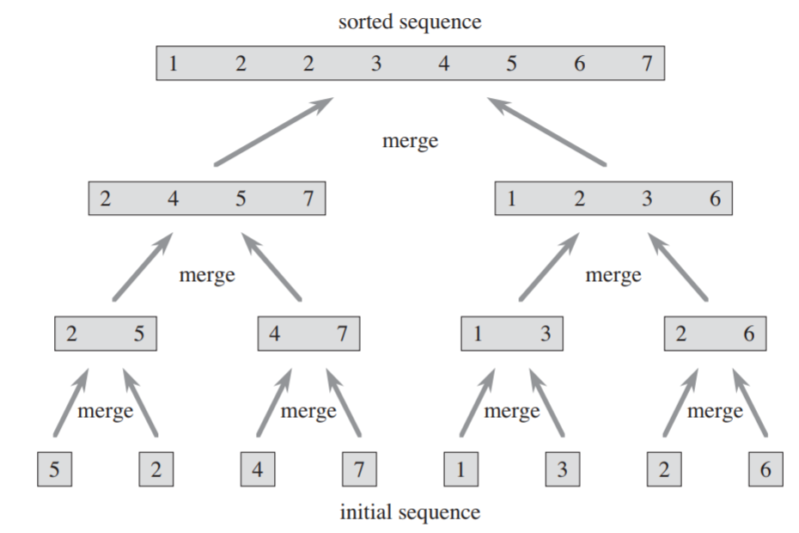
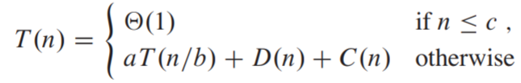
Merge sort: a divide and conquer algorithm
Insertion sort is O(n²). Merge sort is O(n log n)

Slide 13
Conclusion
Big Oh notation is widely used to analyze the complexity of an algorithm
Can be useful when you are trying to optimize your code

